Slide 1

Go, change the world
RV College of
Engineering
Implementation of Red-Black trees
Neha N 1RV20CS094
Nimisha 1RV20CS098

Slide 2

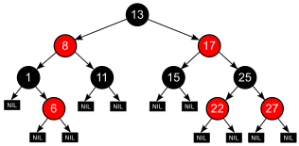
Go, change the world
RV College of
Engineering
INTRODUCTION
What are Red-Black trees?
A red-black tree is a kind of self-balancing binary search tree where each node has an extra bit, and that bit is often interpreted as the colour (red or black). These colours are used to ensure that the tree remains balanced during insertions and deletions.
How does a Red-Black Tree ensure balance?
The red-black color is meant for balancing the tree.The limitations put on the node colors ensure that any simple path from the root to a leaf is not more than twice as long as any other such path. It helps in maintaining the self-balancing property of the red-black tree.

Slide 3
Go, change the world
RV College of
Engineering
STRUCTURE OF RED BLACK TREE
Properties
Each node is either red or black
8
The root of the tree is always black.
All leaves are null and they are black.
The children of any red node are black.
5
8
Any path from a given node to any of its descendant leaves contains the same number of black nodes.
The black depth of a node is defined as the number of black nodes from the root to that node i.e the number of black ancestors. The black height of a node is the number of black nodes from the given node to any of its descendant child nodes (including the child node).
Number of nodes from a node to its farthest descendant leaf is no more than twice as the number of nodes to the nearest descendant leaf. Red-Black Tree of height h has black-height >= h/2.
Every Red Black Tree with n nodes has height <= 2Log2(n+1).
15
nil
nil
12
19
nil
9
13
23
nil
nil
nil
nil
nil
nil

Slide 4
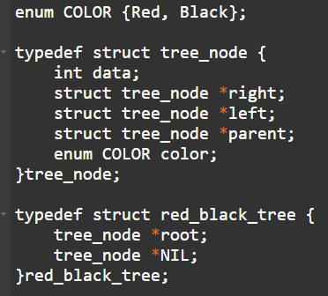
Go, change the world
19
RV College of
Engineering
STRUCTURE OF RED BLACK TREE
Each node has the following attributes:
color
key
leftChild
rightChild
parent (except root node)
8

Slide 5
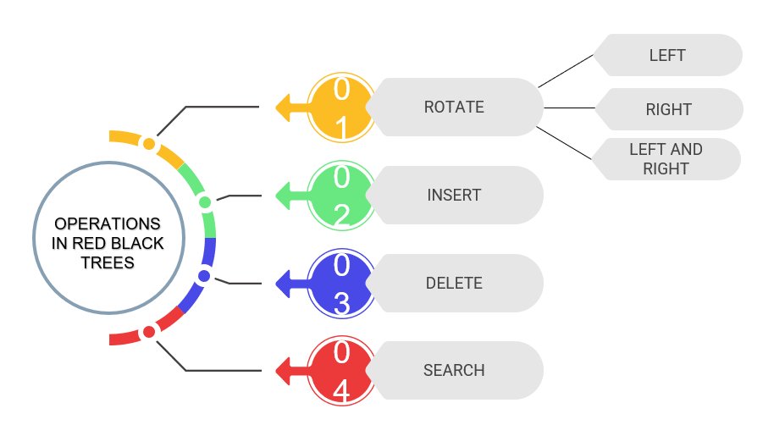
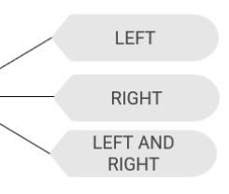
Go, change the world
RV College of
Engineering
OPERATIONS ON RED BLACK TREES
Element
Minimum
Maximum

Slide 6
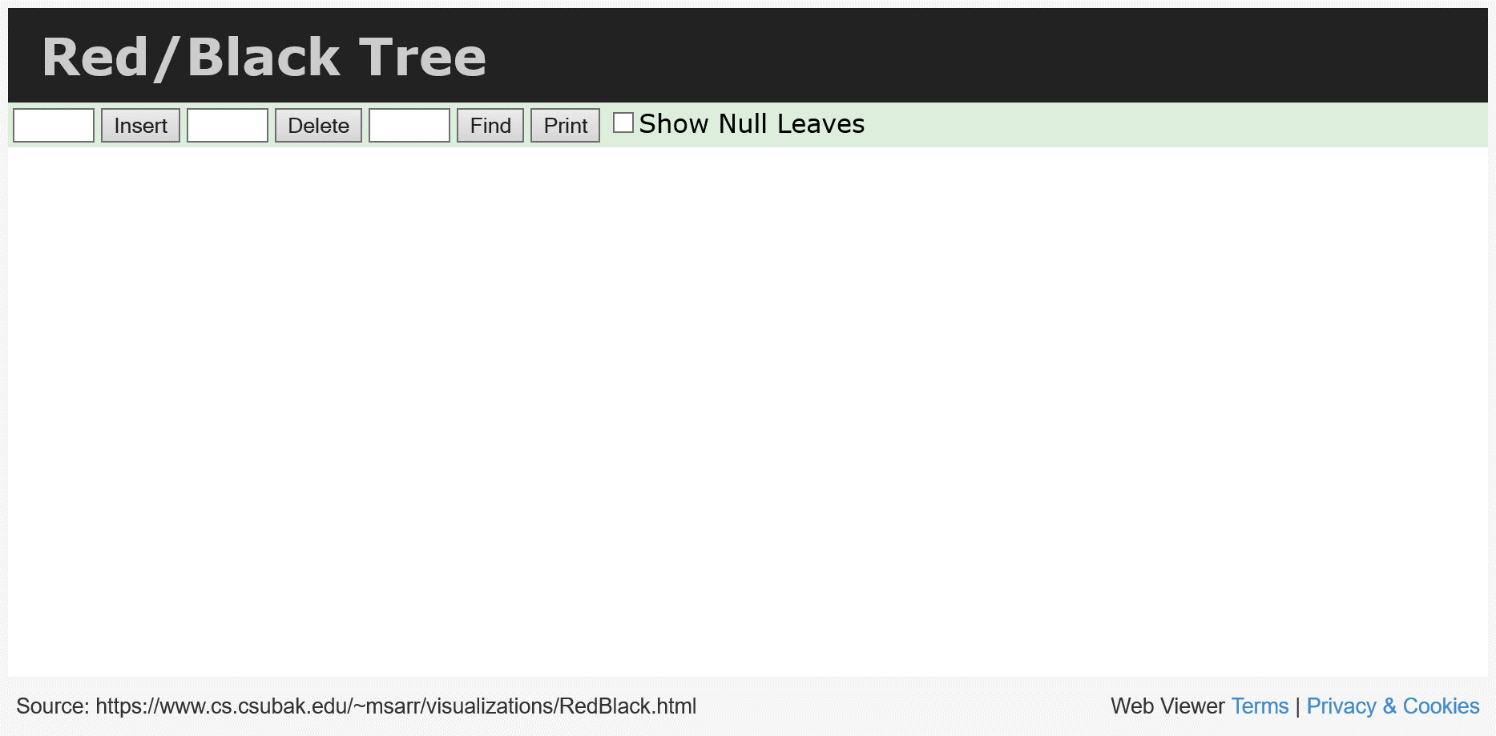
Go, change the world
RV College of
Engineering
OPERATIONS ON RED BLACK TREES

Slide 7
Go, change the world
RV College of
Engineering
OPERATIONS ON RED BLACK TREES
1) Rotation
In rotation operation, the positions of the nodes of a subtree are interchanged. Rotation operation is used for maintaining the properties of a red-black tree when they are violated by other operations such as insertion and deletion.
There are 3 types of rotation
1a) Left rotate
1b) Right rotate
1c) Left-Right rotate

Slide 8
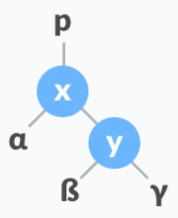
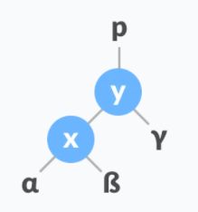
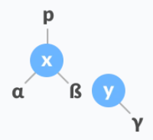
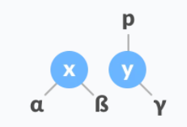
Go, change the world
RV College of
Engineering
OPERATIONS ON RED BLACK TREES
1a) Left rotation
Algorithm
Let initial tree be
1. If y has a left subtree, assign x as the parent of the left subtree of y
2. Change parent of x to that of y
a.If the parent of x is NULL, make y as the root of the tree
b.Else if x is the left child of p, make y as the left child of p
c.Else assign y as the right child of p
3. Make y as the parent of x
To perform LeftRotate(x,y)

Slide 9
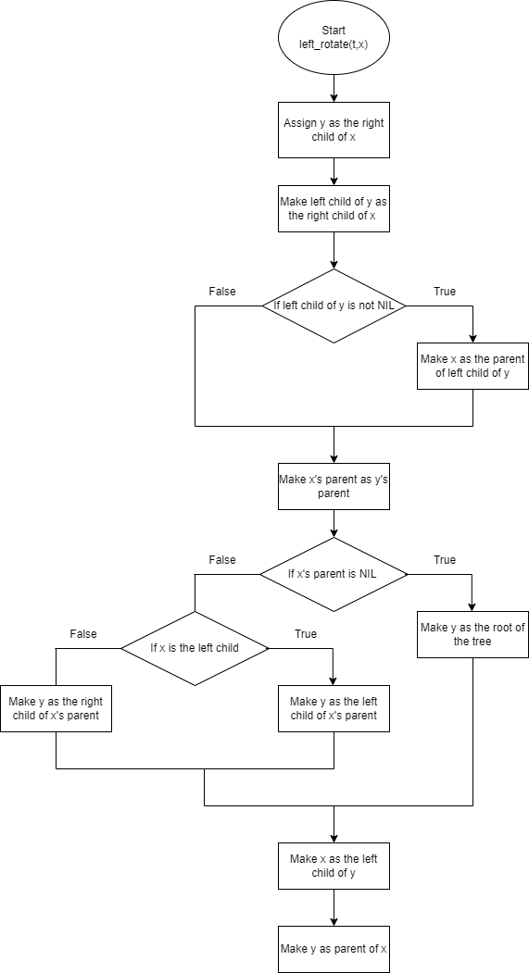
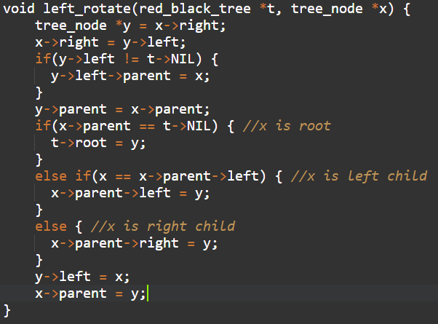
Go, change the world
RV College of
Engineering
OPERATIONS ON RED BLACK TREES

Slide 10
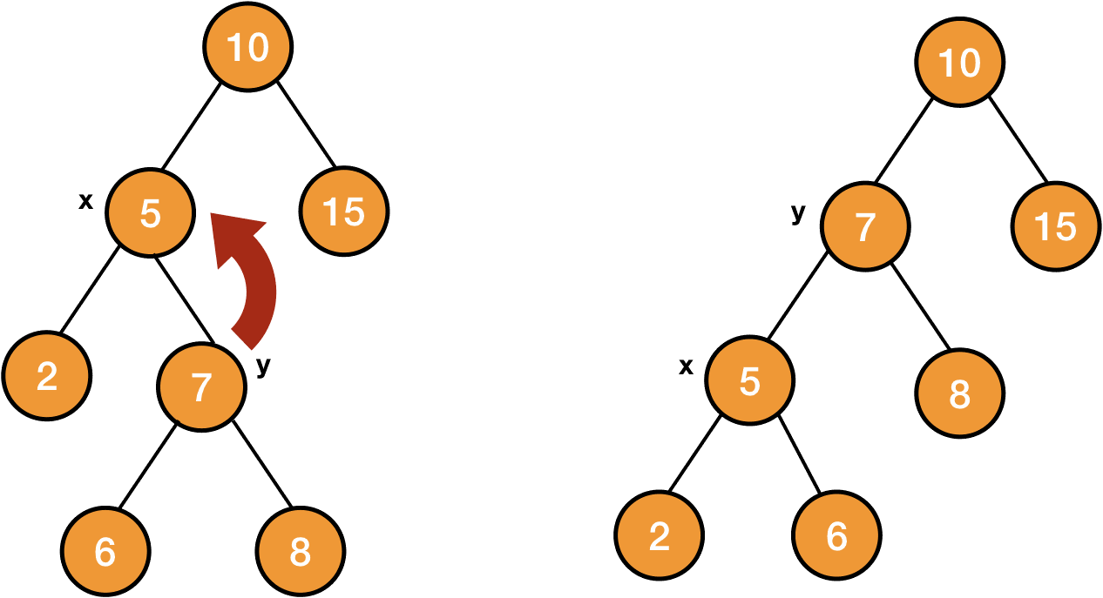
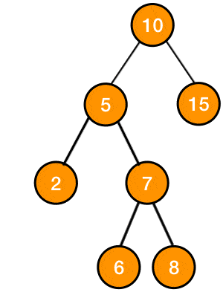
Go, change the world
RV College of
Engineering
OPERATIONS ON RED BLACK TREES

Slide 11
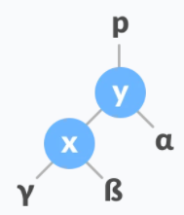
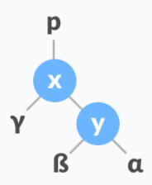
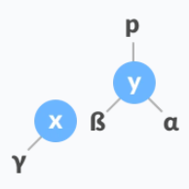
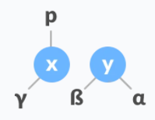
Go, change the world
RV College of
Engineering
OPERATIONS ON RED BLACK TREES
1a) Right rotation
Algorithm
Let initial tree be
1. If x has a right subtree, assign y as the parent of the right subtree of x
2. Change parent of y to that of x
a.If the parent of y is NULL, make x as the root of the tree
b.Else if y is the right child of its parent p, make x as the right child of p
c.Else assign x as the left child of p
3. Make x as the parent of y
To perform RightRotate(y,x)

Slide 12
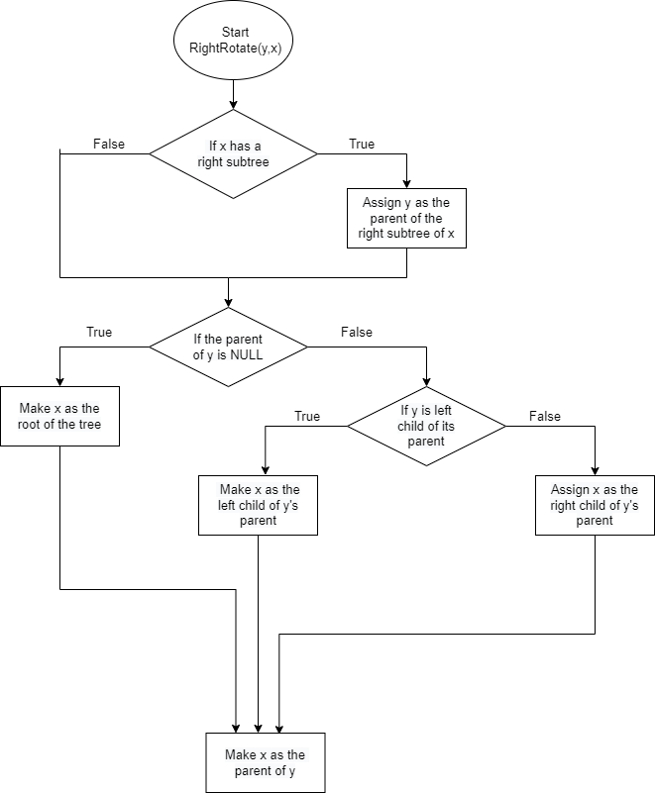
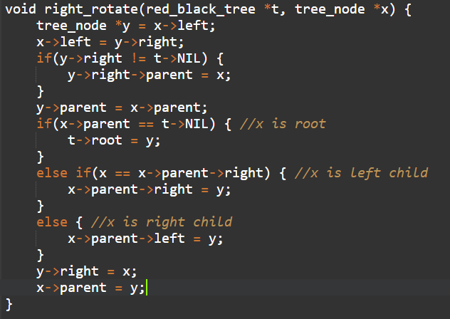
Go, change the world
RV College of
Engineering
OPERATIONS ON RED BLACK TREES
Flowchart

Slide 13
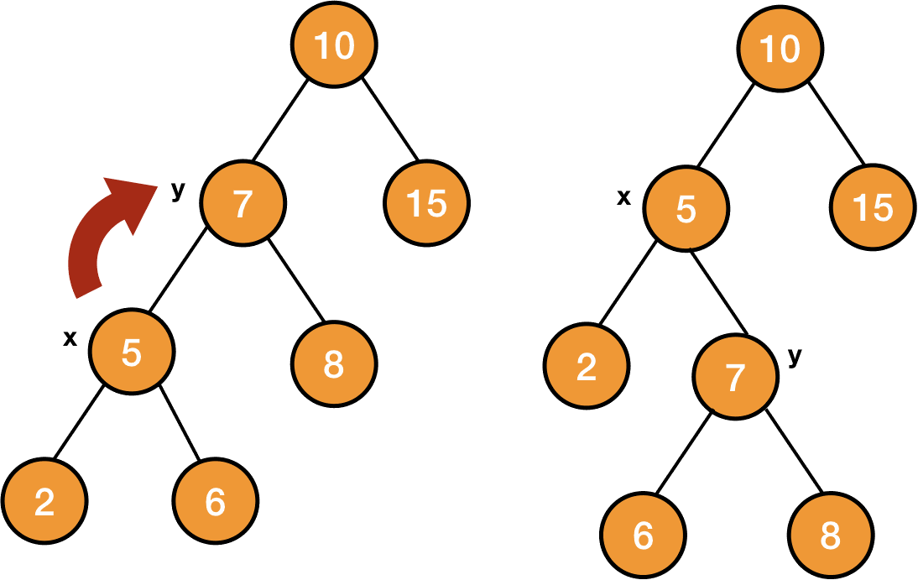
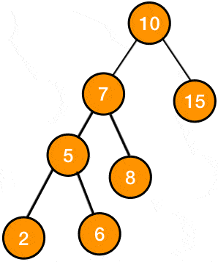
Go, change the world
RV College of
Engineering
OPERATIONS ON RED BLACK TREES
x
y
y
x

Slide 14
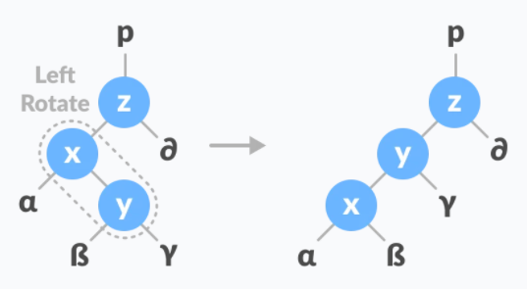
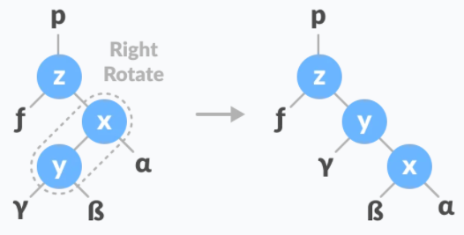
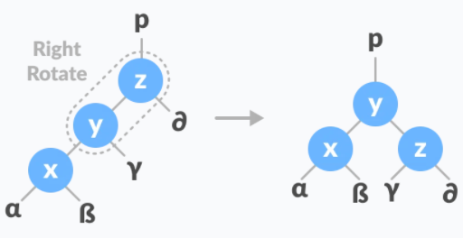
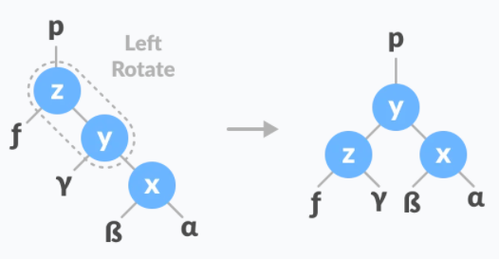
Go, change the world
RV College of
Engineering
OPERATIONS ON RED BLACK TREES
1c) Left and Right rotation
Algorithm
Left-Right rotation
Left-Right rotation
1.Do left rotation on x-y
1.Do right rotation on x-y
2.Do right rotation on y-z
2.Do left rotation on y-z

Slide 15
Go, change the world
RV College of
Engineering
OPERATIONS ON RED BLACK TREES
2) Insert
While inserting a new node, the new node is always inserted as a RED node. After insertion of a new node, if the tree is violating the properties of the red-black tree then, we do the following operations.
Recolor
Rotation
Why newly inserted nodes are always red in a red-black tree?
This is because inserting a red node does not violate the depth property of a red-black tree.
If you attach a red node to a red node, then the rule is violated but it is easier to fix this problem than the problem introduced by violating the depth property.

Slide 16
Go, change the world
RV College of
Engineering
OPERATIONS ON RED BLACK TREES
Algorithm for insert operation
Let ‘y’ be the leaf (ie. NIL) and ‘temp’ be the root of the tree.
Check if the tree is empty (ie. whether x is NIL). If yes, insert newNode as a root node and color it black.
Else, repeat steps following steps until leaf (NIL) is reached.
Compare newKey with rootKey.
If newKey is greater than rootKey, traverse through the right subtree.
Else traverse through the left subtree.
Assign the parent of the leaf as a parent of newNode.
If leafKey is greater than newKey, make newNode as rightChild.
Else, make newNode as leftChild.
Assign NULL to the left and rightChild of newNode.
Assign RED color to newNode.
Call InsertFix-algorithm to maintain the property of red-black tree if violated.

Slide 17
Go, change the world
RV College of
Engineering
OPERATIONS ON RED BLACK TREES
Algorithm to maintain red-black property after insertion
Do the following while the parent of newNode p is RED.
If p is the left child of uncle of z, do the following. Case-I:
If the color of the right child of uncle of z is RED, set the color of both the children of uncle as BLACK and the color of uncle as RED.
Assign uncle to newNode. Case-II:
Else if newNode is the right child of p then, assign p to newNode.
Left-Rotate newNode. Case-III:
Set color of p as BLACK and color of uncle as RED.
Right-Rotate uncle.

Slide 18
Go, change the world
RV College of
Engineering
OPERATIONS ON RED BLACK TREES
Algorithm to maintain red-black property after insertion (continued)
3. Else do the following
If the color of the left child of uncle of z is RED, set the color of both the children of uncle as BLACK and the color of uncle as RED.
Assign uncle to newNode
Else if newNode is the left child of p then, assign p to newNode and Right-Rotate newNode
Set color of p as BLACK and color of uncle as RED.
Left-Rotate uncle
4.Set the root of the tree as BLACK.

Slide 19
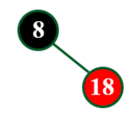

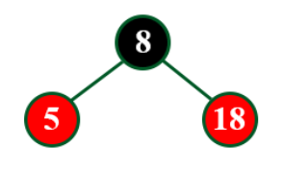
Go, change the world
RV College of
Engineering
OPERATIONS ON RED BLACK TREES
Example: Creating a RED BLACK Tree by inserting following sequence of number:
8,18, 5, 17, 25, 40, 80
Insert 8
Insert 18
Insert 5
Root node is always black in color.
If the tree is not empty, every new node to be inserted is red in color.
Initially a new node is inserted in the same way as in BST.

Slide 20
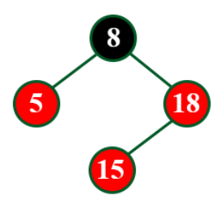
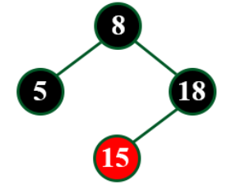
Go, change the world
RV College of
Engineering
OPERATIONS ON RED BLACK TREES
Insert 15
After recoloring
Based on the color of uncle
Violating the property: Red Red conflict
If the uncle is Red in color, recoloring is done (No rotations required).

Slide 21
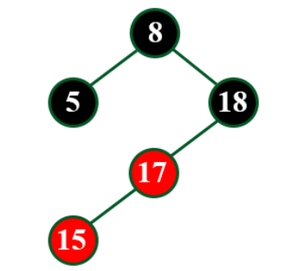
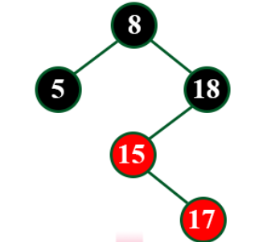
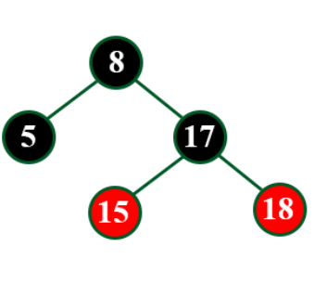
Go, change the world
RV College of
Engineering
OPERATIONS ON RED BLACK TREES
After right rotation and recoloring
After left rotation
Insert 17
L
If uncle is Black in color, appropriate rotation and recoloring has to done.
R

Slide 22
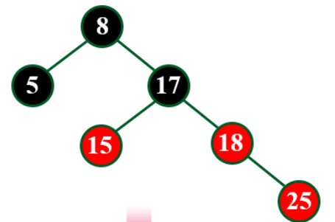
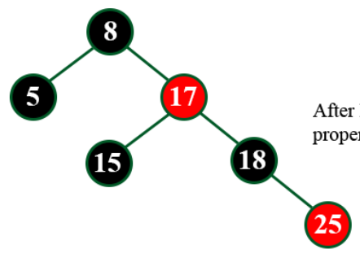
Go, change the world
RV College of
Engineering
OPERATIONS ON RED BLACK TREES
Insert 25
After recolor
Violating the property: Red Red conflict
Since the uncle is red in color, parent is recolored to black and grandparent to red, thus satisfying the properties.

Slide 23
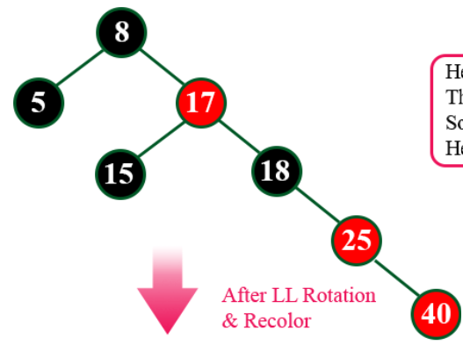
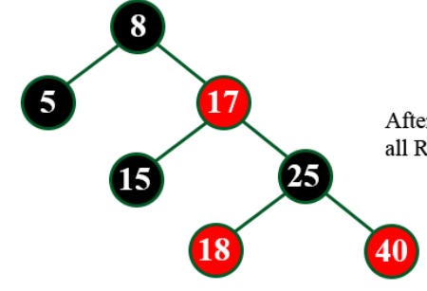
Go, change the world
RV College of
Engineering
OPERATIONS ON RED BLACK TREES
Insert 40
After left rotation and recolor
R
R
Since the uncle i.e., NIL is black in color, Left rotation is performed (RR) and is recolored.
Violating the property: Red Red conflict

Slide 24
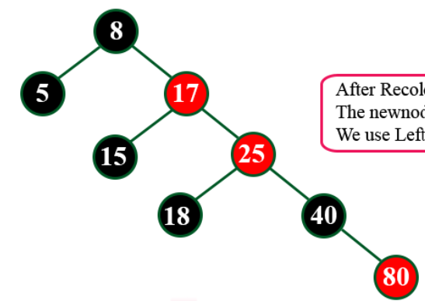
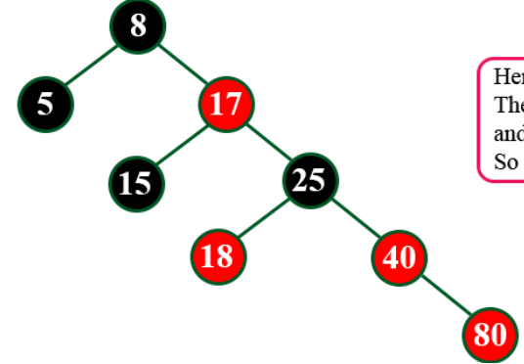
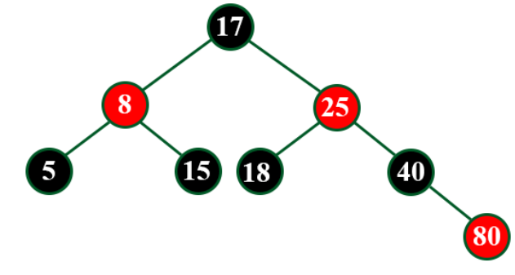
Go, change the world
RV College of
Engineering
OPERATIONS ON RED BLACK TREES
R
Red Red conflict
R
After recoloring
After left rotation and recoloring
Insert 80
Red Red conflict

Slide 25
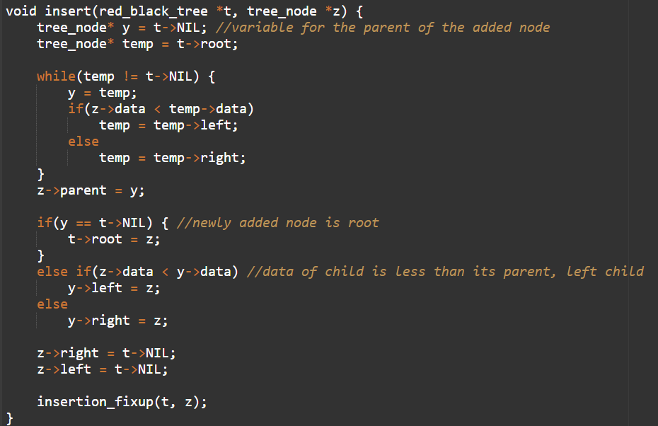
Go, change the world
RV College of
Engineering
OPERATIONS ON RED BLACK TREES
Code

Slide 26
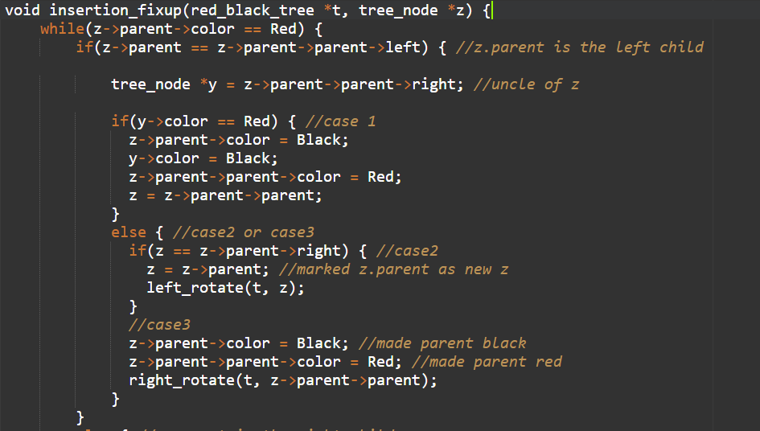
Go, change the world
RV College of
Engineering
OPERATIONS ON RED BLACK TREES
Code

Slide 27
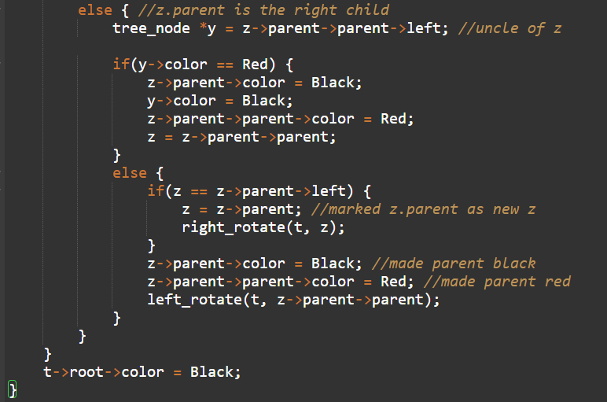
Go, change the world
RV College of
Engineering
OPERATIONS ON RED BLACK TREES
Code

Slide 28
Go, change the world
RV College of
Engineering
OPERATIONS ON RED BLACK TREES
3) Delete
This operation removes a node from the tree. After deleting a node, the red-black property is maintained again.
Algorithm for delete operation
Save the color of nodeToBeDeleted in origrinalColor.
If the left child of nodeToBeDeleted is NULL
Assign the right child of nodeToBeDeleted to x.
Transplant nodeToBeDeleted with x.
Else if the right child of nodeToBeDeleted is NULL
Assign the left child of nodeToBeDeleted into x.
Transplant nodeToBeDeleted with x.

Slide 29
Go, change the world
RV College of
Engineering
OPERATIONS ON RED BLACK TREES
Algorithm for delete operation (continued)
4.Else
Assign the minimum of right subtree of noteToBeDeleted into y.
Save the color of y in originalColor.
Assign the rightChild of y into x.
If y is a child of nodeToBeDeleted, then set the parent of x as y.
Else, transplant y with rightChild of y.
Transplant nodeToBeDeleted with y.
Set the color of y with originalColor.
5.If the originalColor is BLACK, call DeleteFix(x)

Slide 30
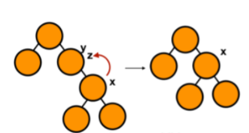
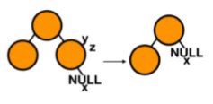
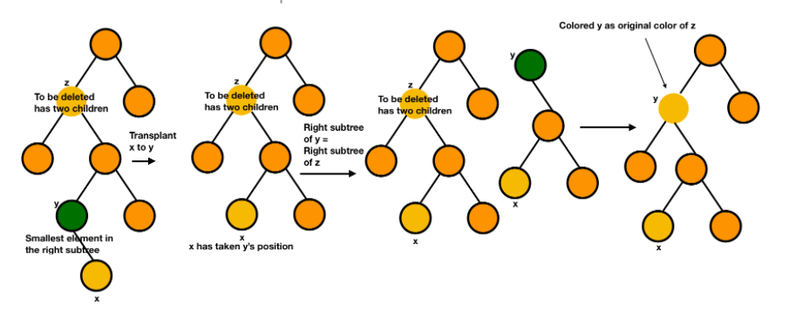
Go, change the world
RV College of
Engineering
OPERATIONS ON RED BLACK TREES
Case 1: z has no child
Case 2: z has either left or right child
Case 3: z has both right and left children

Slide 31
Go, change the world
RV College of
Engineering
OPERATIONS ON RED BLACK TREES
Algorithm to maintain red-black property after deletion(continued)
Do the following until the x is not the root of the tree and the color of x is BLACK
If x is the left child of its parent then,
Assign w to the sibling of x.
If the right child of parent of x is RED, Case-I:
Set the color of the right child of the parent of x as BLACK.
Set the color of the parent of x as RED.
Left-Rotate the parent of x.
Assign the rightChild of the parent of x to w.

Slide 32
Go, change the world
RV College of
Engineering
OPERATIONS ON RED BLACK TREES
Algorithm to maintain red-black property after deletion (continued)
c.If the color of both the right and the leftChild of w is BLACK
Case-II:
i.Set the color of w as RED
ii.Set the color of w as RED
d.Else if the color of the rightChild of w is BLACK Case-III
i.Set the color of the leftChild of w as BLACK
ii.Set the color of w as RED
iii.Right-Rotate w.
iv.Assign the rightChild of the parent of x to w.
e.If any of the above cases do not occur, then do the following. Case-IV
i.Set the color of w as the color of the parent of x.
ii.Set the color of the parent of x as BLACK.
iii.Set the color of the right child of w as BLACK.
iv.Left-Rotate the parent of x.
v.Set x as the root of the tree.
3.Else the same as above with right changed to left and vice versa.
4.Set the color of x as BLACK.

Slide 33

Go, change the world
RV College of
Engineering
OPERATIONS ON RED BLACK TREES
Algorithm to maintain red-black property after deletion
This algorithm is implemented when a black node is deleted because it violates the black depth property of the red-black tree.
This violation is corrected by assuming that node x (which is occupying y's original position) has an extra black. This makes node x either doubly black or black-and-red. This violates the red-black properties.
The extra black has to be removed
If x is red and black, we can simply color it black and this will fix the violation
If x is doubly black and the root, we can simply remove one extra black
If x is doubly black and not the root then suitable rotations and recoloring are performed.

Slide 34
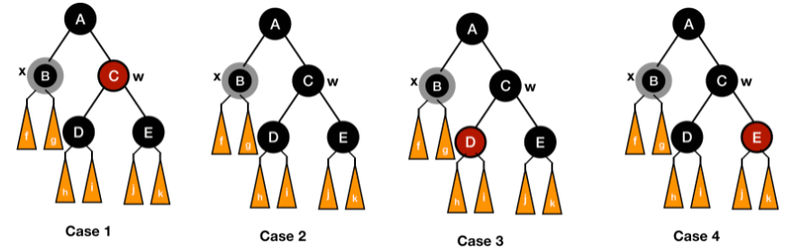
Go, change the world
RV College of
Engineering
OPERATIONS ON RED BLACK TREES
There will be 4 cases (w is sibling of x)
w is red.
w is black and its both children are black.
w is black and its right child is black and left child is red.
w is black and its right child is red.

Slide 35
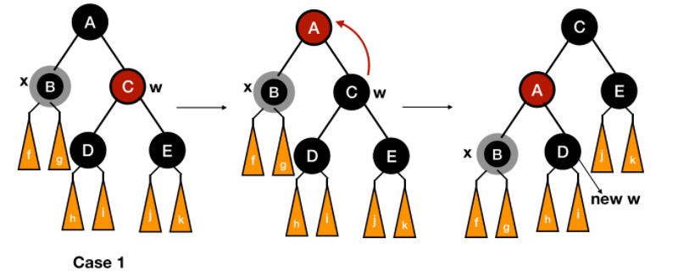
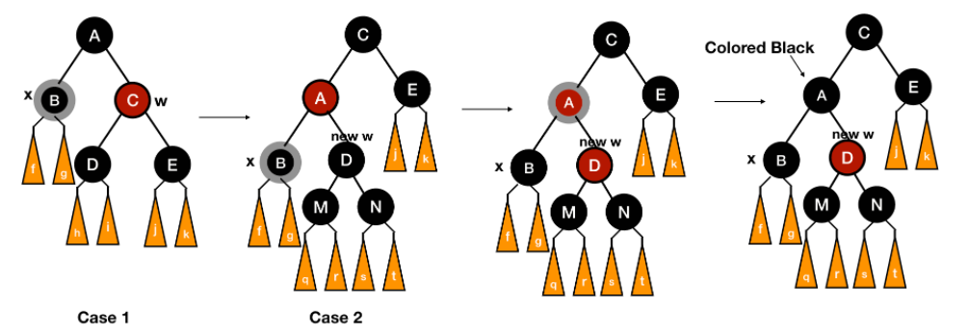
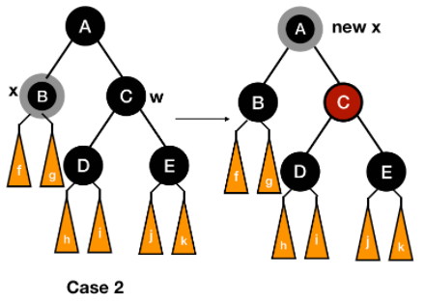
Go, change the world
RV College of
Engineering
OPERATIONS ON RED BLACK TREES
Case 1: For the first case, we can switch the colors of w and its parent and then left rotate the parent of x. In this way, we will enter either case 2, 3 or 4.
Case 2: For the second case, we will take out one black from both x and w. This will leave x black (it was double black) and y red. For the compensation, we will put one extra black on the parent of x and mark it as the new x and repeat the entire process of fixing the violations for the new x.
Also if we have entered case 2 from case 1, the parent must be red. Now the node becomes both red and black, so it will be simply fixed by coloring it black.

Slide 36
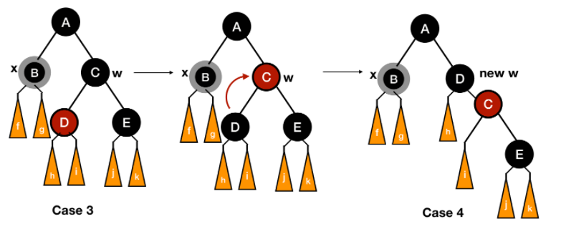

Go, change the world
RV College of
Engineering
OPERATIONS ON RED BLACK TREES
Case 3: We will transform case 3 to case 4 by switching the colors of w and its left child and then rotating right w.
Case 4: We first colored w same as the parent of x and then colored the parent of x black. After this, we colored the right child of w black and then left rotated the parent of x. At last, we removed extra black from x without violating any properties.

Slide 37


Go, change the world
RV College of
Engineering
OPERATIONS ON RED BLACK TREES
Code

Slide 38

Go, change the world
RV College of
Engineering
OPERATIONS ON RED BLACK TREES
Code

Slide 39


Go, change the world
RV College of
Engineering
OPERATIONS ON RED BLACK TREES
4) Search
4a) Search for an element
Compare the element with the root of the tree.
If the item is matched then return the location of the node.
Otherwise check if item is less than the element present on root, if so then move to the left sub-tree.
If not, then move to the right subtree.
Repeat this procedure recursively until match found.
If element is not found then return NULL.

Slide 40




Go, change the world
RV College of
Engineering
INTRODUCTION
4b) Search for minimum element
4c) Search for maximum element
Start from root node
Go to left child
Keep on repeating this process recursively until leftmost leaf node is found - this node has the minimum element
Start from root node
Go to right child
Keep on repeating this process recursively until rightmost leaf node is found - this node has the minimum element.

Slide 41

Go, change the world
RV College of
Engineering
IMPLEMENTATION

Slide 42
Go, change the world
RV College of
Engineering
ADVANTAGES AND DISADVANTAGES
Advantages
Most of the BST operations (e.g., search, max, min, insert, delete.. etc) take O(h) time where h is the height of the BST. The cost of these operations may become O(n) for a skewed Binary tree.
If we make sure that the height of the tree remains O(log n) after every insertion and deletion, then we can guarantee an upper bound of O(log n) for all these operations.
The height of a Red-Black tree is always O(log n) where n is the number of nodes in the tree.
Disadvantages
Relatively complicated to implement because of all the operation edge cases

Slide 43
Go, change the world
RV College of
Engineering
APPLICATIONS
Red–black trees offer worst-case guarantees for insertion time, deletion time, and search time.
Not only does this make them valuable in time-sensitive applications such as real-time applications, but it makes them valuable building blocks in other data structures which provide worst-case guarantees
For example, many data structures used in computational geometry can be based on red–black trees, and the Completely Fair Scheduler used in current Linux kernels uses red–black trees.
Linux also uses red-black trees in the mmap and munmap operations for file/memory mapping.
TreeSet, TreeMap, and Hashmap in the Java Collections Library use red black trees.
Red-black trees are used for geometric range searches, k-means clustering, and text-mining.

